Slide 1
Capstone Project: Crime Time
A Machine Learning Analysis

Slide 2
Random Crime Classifiers
Randy Melancon
Matthew Parrish
Jarod Peters
Andres Rosas
Melissa Weston-Puett
Team Members

Slide 3
Topic: Crime in Chicago
Questions
Reason
Data
Can an arrest for a crime be predicted based on the location, time, and type of crime perpetrated?
What is the most common crime?
How does arrest rate differ by crime?
How does crime differ by district?
What time is more common for crimes to be committed?
Common interest among members of team
Enjoy reading about crime and listening to true crime podcasts
Interest in assisting police departments in the future.
Crime datasets were found and downloaded from Data.gov
Focus on years 2015 - 2021
Included over 1 million rows of data
Notes:
The City of Chicago has a long history of crime. The overall crime rate is higher than that of the national average. In fact, the chance of becoming a victim of either a violent crime or property crime in Chicago is 1 in 28. Unfortunately, many crimes reported do not result in an arrest. This project examines crime data reported in the city of Chicago from 2015 to present to determine if an arrest for a crime can be predicted based on location, time, and crime perpetrated.

Slide 4
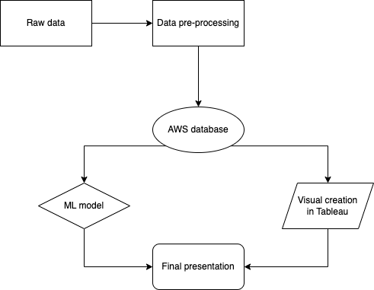
Overview

Slide 5
Technology and Tools
Pandas library/Jupyter Notebook
Random Forest Classifier
Data PreProcessing
Database
Machine Learning
Dashboard
Tableau
pgAdmin to create & connected to AWS using sqlalchemy
Notes:
Pre-Process: Used pandas and jupyter notebook to clean the data and remove anything that was not useful to our analysis
Database: A database was initially created using Postgres via pdAmin. Two tables were created from the raw data and merged to
make the final data file used for data analysis
Machine Learning: We chose a supervised learning model because we are attempting to predict arrests based on data from previous arrests.

Slide 6
Data Preprocessing
Data were filtered or dropped initially with Pandas using the following criteria:
1. Data were filtered by date to include years 2015 and forward.
2. Rows including NaNs and empty cells were deleted.
3. Columns not contributing to our data inquiry were dropped.
To prepare for ML model:
Columns dropped that were not meaningful to model
Encoded data so that variable types were numeric
Time columns binned into groups of hours throughout day
Month extracted from date column
Notes:
1A.Dropped years before 2015 so that we had a easier time working w/ the RAW data
2A.Removed Data that had missing values to make the data reliable
3A&1B.Dropped extra columns like the beat, IUCR, FBI code, etc.
2B. Changed the variable types to numeric values so that the machine learning model could run smoothly
3B.binned the time columns into hours to break the days up and show if certain hours are more likely to have a certain crime occur
4B.binned the date columns into months to break the year up and show if certain quarters are more likely to have a certain crime occur

Slide 7


Database
pgAdmin used to create database
Consisted of two tables from cleaned data and a third table created by an inner join
Hosted on AWS so that all team members had access
Connected to ML model by using SQLAlchemy connection string

Slide 8
Machine Learning
Model
Target
Features
Predict if an arrest can be made
Supervised model
Random Forest Classifier
Arrests
Primary type
Latitude
Longitude
Location description
Month
Time binned
District
Notes:
Began with extracting the dataset from database
Then used supervised ml model randomforest
We chose supervised model
Bc we already know what we are looking for (character of supervised modeling)
Looking to use model to determine if there was an arrest or not depending on the characteristic of the crime, location, and time.
Target is if there was an arrest or not
Feature, several features dropped (deemed not needed)

Slide 9
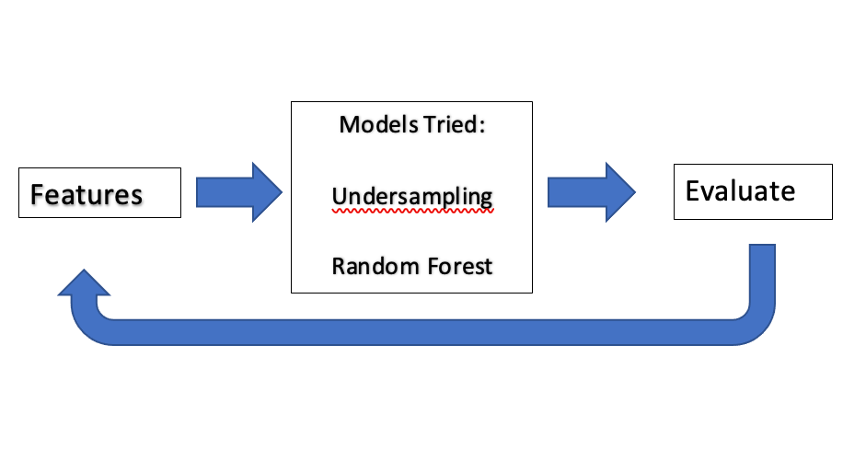
Data Exploration with Model
Notes:
Tried undersampling vs randomforest
RandomForest chosen bc:
Resistant to overfitting
Good to run on large datasets
Resistant to outliers
After running random forest once, we ranked the importance of each feature, and dropped those with low ranking

Slide 10
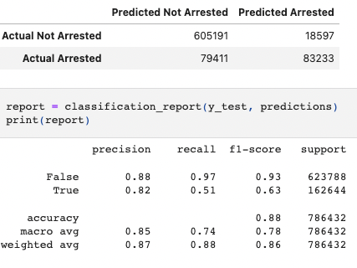

Key Results
Notes:
Our goal was to be able to accurately predict if an arrest is made according to type of crime and the time and location of which the crime is committed. After using the Random Forest Classifier to predict our target based on relative features, our accuracy score is 87.5%. This means that the model correctly predicted the arrest for 87.5% of the crimes. According to our classification report, the precision for prediction of the arrests and nonarrests are in line with each other. However, the recall (sensitivity) for predicting arrest is much lower than for predicting no arrest. This measure indicates the correct positive predictions relative to the total actual positives.The average F-1 score of 0.78 indicates that there is a fairly high balance between recall and precision. Thus, as the model is now, it is marginally successful at predicting whether an arrest is made. Even if the accuracy score could be better, the confusion matrix indicates the model is performing well finding the positive true arrests (true positive)and the negative nonarrests (true negative).

Slide 11

Additional Interesting Finds

Slide 12
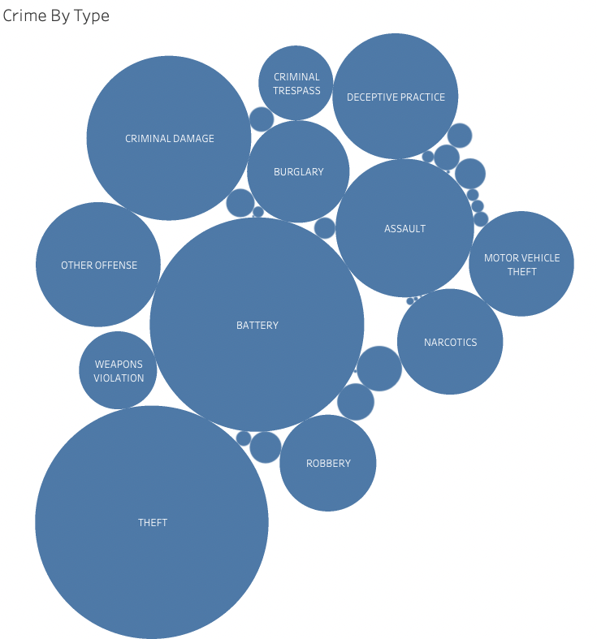
Most Common Types of Crime
Notes:
This graph provides a visual representation of the crimes that are most often committed. The larger circles represent a higher occurrence of the particular type of crime and we can see that theft and battery are the crimes that are committed the most.

Slide 13
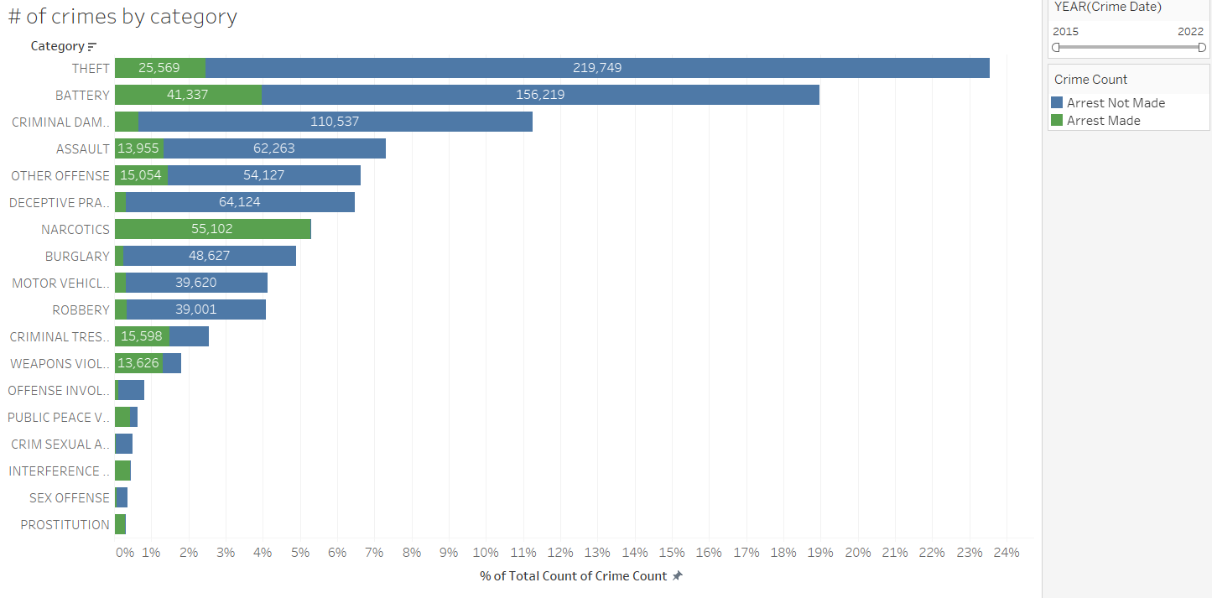
Arrest Rate by Crime
Notes:
This bar graph provides a visual representation of what we saw in the previous bubble chart. However, this chart also shows a visual of the amount of crimes where an arrest was made to compare to when an arrest was not made. Green indicates an arrest being made where blue represents a crime where an arrest has not been made. There are some categories where an arrest rate is higher and we believe this is due to type of crime and action associated with the crime. For example if you are caught with narcotics, you get arrested and same is true for a category like prostituion where you are either caught in the act or not.

Slide 14
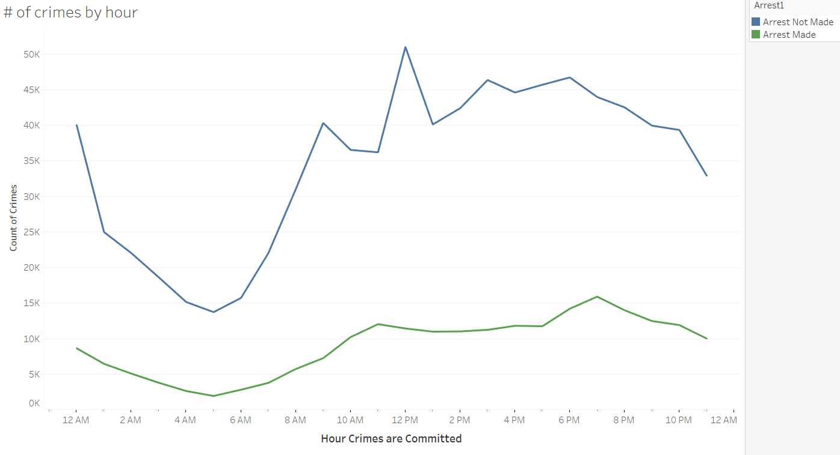
Crime Time
Notes:
This line graph shows the amount of crimes when an arrest was made or not made based on the hour of the day in which the crime was reported. Based on this data, noon is the time where criminals are most successful at committing crimes without being caught. (insert joke about spreading out lunch breaks). Based on this data, 7 pm is the time when the most arrests are made.

Slide 15
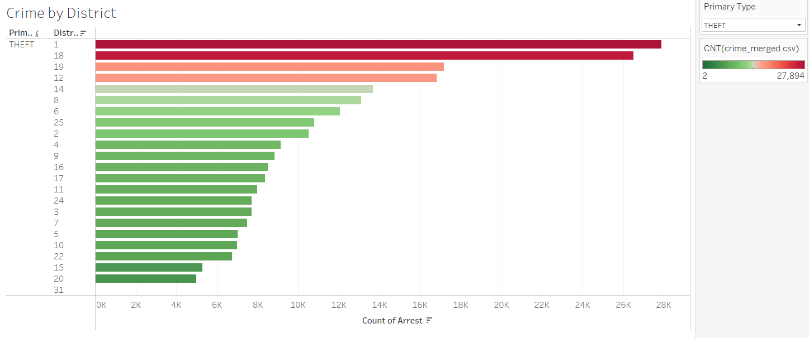
Crime by District
Notes:
To get a little more granular, this graph shows how the district ranks based on the type of crime committed in each district. District 1 and 18, reported the two highest amount of thefts out of all the districts in chicago.

Slide 16
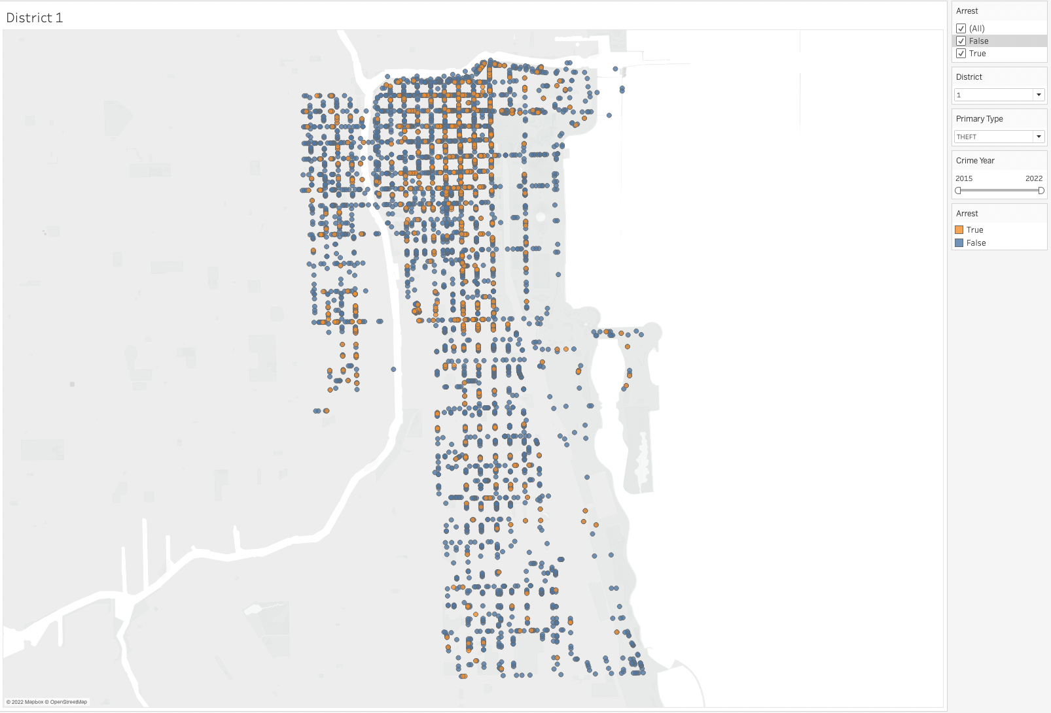
Arrest Rate by District
Can be filtered by:
Type of Crime
Year
Arrest
District
Notes:
The heatmap belows show the arrest rate for District 1. This graph is interactive and the district can be changed in order to see how districts are performing individually.
Can be filtered by type of crime, year, district Expand a bit on what we are looking at before it is filtered to show interactivity

Slide 17
Summary
Random Forest Classifier was applied to predict arrest with 87.5% accuracy
Top Five: Theft, battery, criminal damage, deceptive practice, assault
Top five categories have an arrest rate of less than 50%
Types of crime and arrest rates vary considerably across districts
Most arrests occur during the evening hours.
Notes:
The ability of machine learning algorithms to handle multidimensional data efficiently and quickly have given researchers the ability to predict crimes based on certain indicators. Accurate crime prediction and future forecasting trends can assist law enforcement to enhance safety and security
Our project examined a set of data that included several types of crimes (excluding homicides) and whether someone was arrested for an incidence or not. We applied the Random Forest Classifier against the features of type of the crime, location, month, time, and the district in which the crime occurred. We were able to predict an arrest with an accuracy of 87.5%.
Other analyses revealed that theft, battery, criminal damage, deceptive practice and assault were the top five crimes observed in Chicago. None of these categories included an arrest rate of even close to 50%. Districts were also examined with regard to types of crime and arrests rates and results varies considerably from district to district. Lastly, we examined crime during a 24 hour period and found that most arrests occur during the evening hours.
Overall, the key takeaway in this study is that Chicago could be an attractive city for criminals given this data. Thus, empowering police officers with results of predictive analyses is greatly needed.

Slide 18
Recommendations
Examine whether the model performs differently in district/areas where complicated social factors are concentrated
Examine crime rates with respect to distribution of police presence
Examine how crimes committed in different locations and times relate to on another
Notes:
A couple of recommendations we bring forth is that This study could be extended by examining whether the model performed differently in districts or areas where complicated social structures exist such as low income, high poverty, or gang-related neighborhoods.
Studies examining crimes rates with respect to the distribution of police presence and resources could provide insights into potentially better applications of all too often dwindling resources. In addition, deep learning models could be applied to examine how crimes committed in different locations and times relate to one another.

Slide 19
Improvements
Remove year 2021 due to late discovery of data reporting error
Fully investigate more ways to balance the target variable
Design a web page and build visualizations with JavaScript
Notes:
We noticed year 2021 did not have as many data points. Upon further research we discovered too late that a few months of data were missing for this year. Consequently, this year should have been removed from the analysis. Also, we would like to conduct more data exploration to balance the target variable since of the count of non-arrests greatly outweighed the arrests. Lastly, if we would have had more time, we would have liked to design a website and building more interesting visualizations using JavaScript.

Slide 20
Questions?
Notes:
That concludes our presentation so at this time, would like to open the floor to questions.

